Slide 1
Interactive Fiction and Text Generation
Chris Callison-Burch
Lara J. Martin
TAs: Liam Dugan, Artemis Panagopoulou
http://interactive-fiction-class.org

Slide 2

Lara J. Martin she/her or they/them
Postdoc with CCB
Research Interests
Story generation/understanding
NLP for AAC
Speech processing & affective computing
Cognitive modeling
Fun Fact
I collect accents and have a list of English idioms

Slide 3

Chris Callison-Burch he/him
Associate Professor in CIS
Research Interests
Artificial Intelligence
Natural Language Processing
Fun fact:
I collaborated with folks at Google to train an AI system to do Dungeons & Dragons style roleplaying

Slide 4

Liam Dugan he/him
PhD Student
Research Interests:
Natural Language Generation
Human Evaluation
Machine Translation
Fun Fact:
I speak Japanese! 🇯🇵

Slide 5


Artemis Panagopoulou she/her
PhD Student
Research Interests:
Intersection of Computer Vision and NLP
Commonsense Reasoning
Grounding
Fun Fact:
I collect used Greek vinyls 🇬🇷

Slide 6
Icebreaker (Post on Ed Discussion)
What computer games have you been playing (and enjoying) lately?
Alternatively:
What book/TV show/etc. have you been reading/watching/etc. (and enjoying) lately?
https://edstem.org/us/courses/18119/discussion/

Slide 7




Today’s Class
Automated Story Generation
Interactive Fiction
In-Class Activity
Course Overview

Slide 8
Learning Objectives
Identify key characteristics of interactive fiction
Develop an understanding of what it takes to make a simple IF game
Get a brief glimpse into what automated story generation is

Slide 9
Choose-Your-Own Adventures & TRPGs

Slide 10
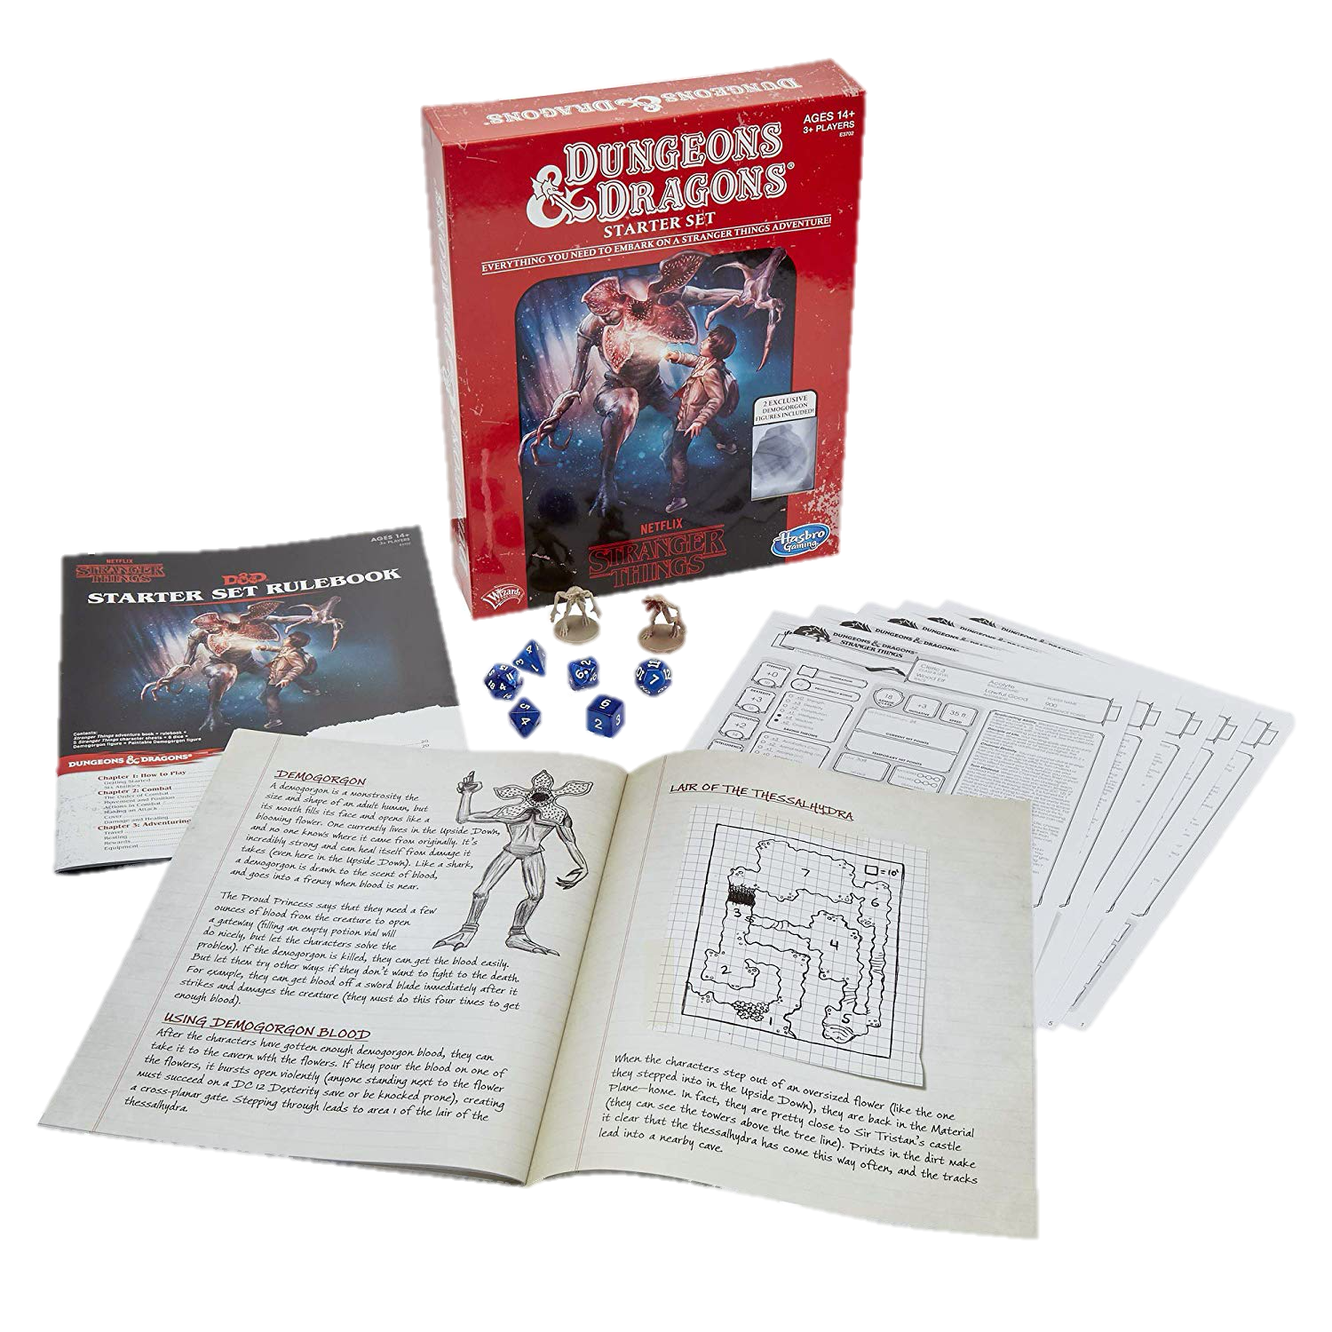
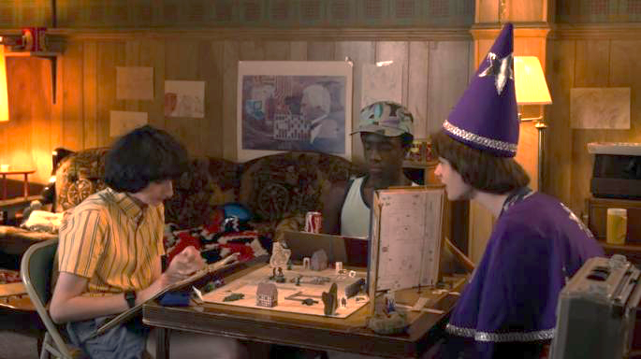
Paper & Pencil Interactive Fiction
Dungeons & Dragons is a fantasy tabletop role playing game first published in 1974.
Notes:
One forebearer of IF is the fantasy role-playing playing game Dungeons and Dragons, a framework for a theatrical interaction, for the exploration of simulated spaces, and for puzzle solving.

Slide 11
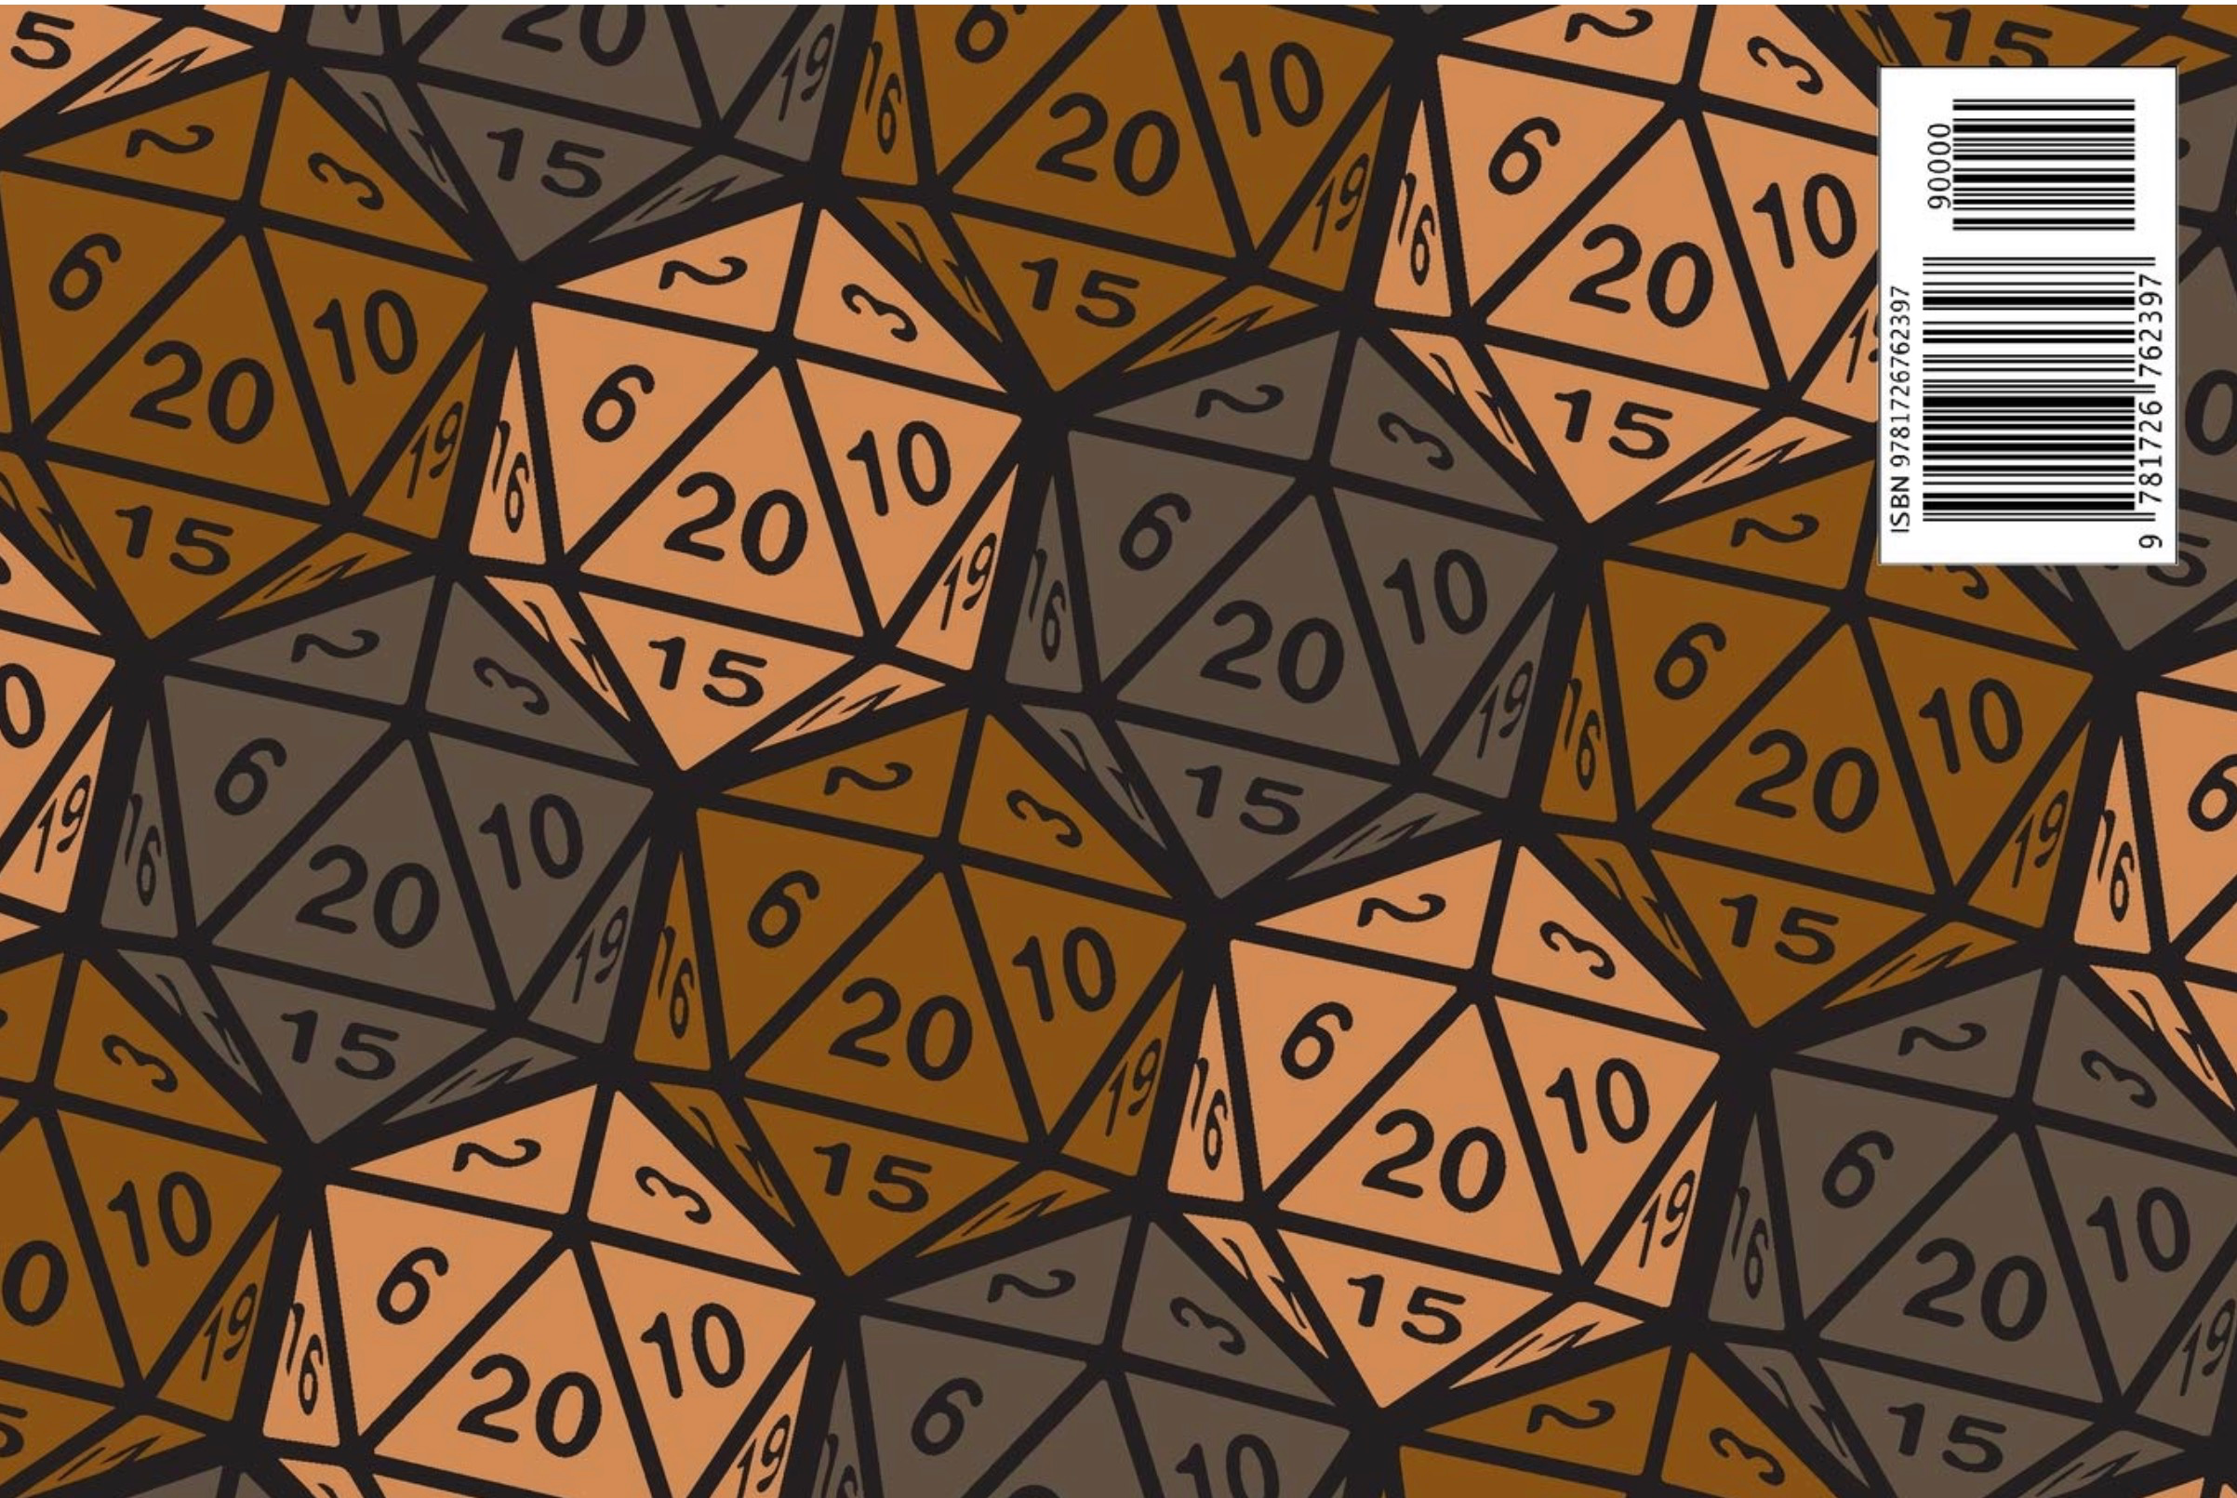
Dungeons and Dragons (D&D)
An open world game in which the players assume the roles of characters in a story and can have them attempt any action they want.
The game is controlled by a dungeon master, who uses tables, dice, and personal judgment to decide on the effect of a character’s efforts.
The players say what their characters do within the world of the campaign (over many play sessions).
Notes:
Dice are rolled to help determine the outcome of combat and other encounters. Over the course of many adventures, the members of a party advance in level and become more powerful-and the dungeon master devises new challenges for them.
Dice, are frequently used in a typical game. The twenty-sided die and other dice of unusual shape have become iconic. Dice are used to introduce unpredictability; based on the roll of a die, events may transpire that were not anticipated, foiling even the dungeon master’s plans.

Slide 12
Old-School Interactive Fiction
Limited Action Space
Full Action Space
Tabletop Roleplaying Games
Choose-Your-Own Adventures
Notes:
Branching narrative vs completely improvised

Slide 13
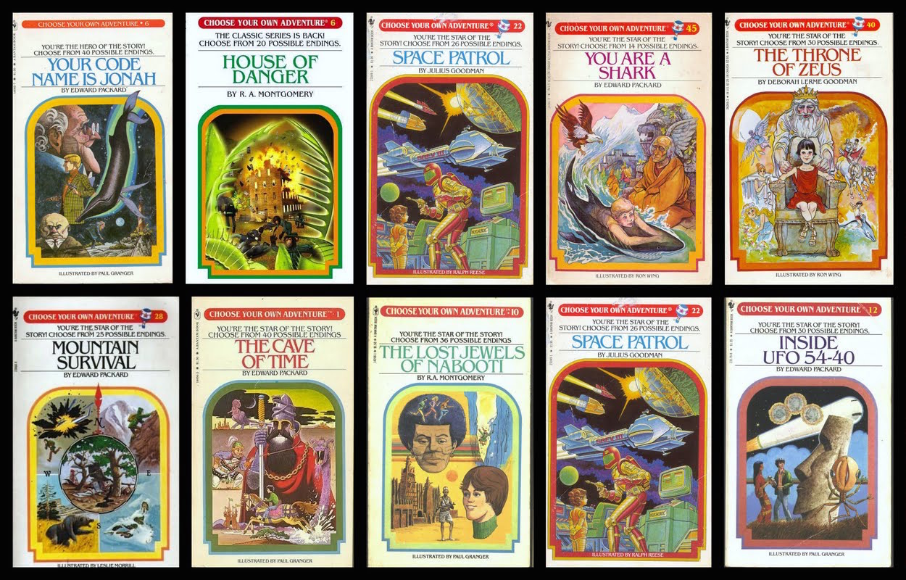
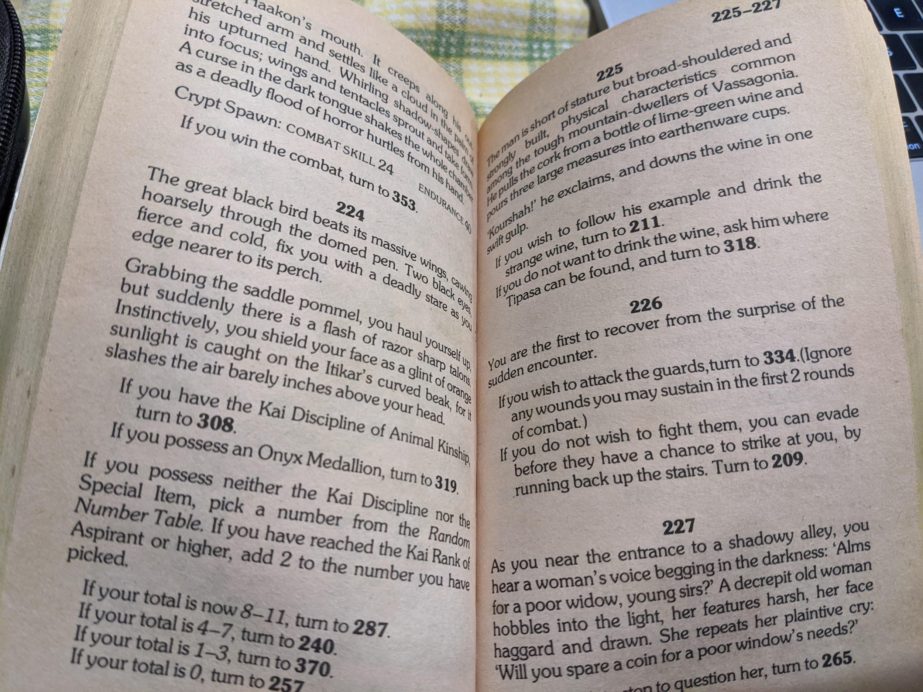
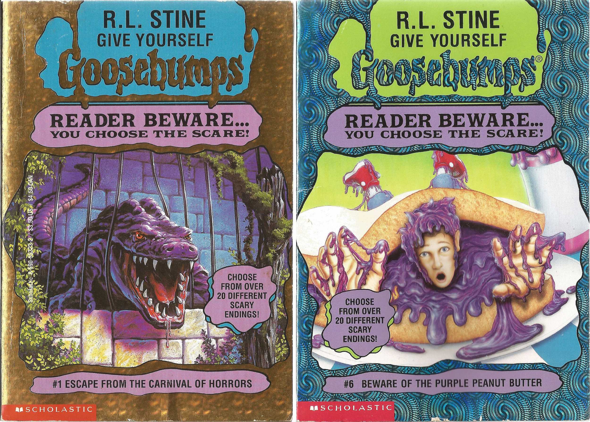
Paper Interactive Fiction
In the late 1970s, “Choose your own adventure” books grew in popularity.
Notes:
If you possess the Onyx Medallion, turn to 319.

Slide 14
Paper Interactive Fiction
In the late 1970s, “Choose your own adventure” books grew in popularity.
TODO: screenshot
Notes:
If you possess the Onyx Medallion, turn to 319.
If you wish to fight them, page 334, otherwise page 209.

Slide 15
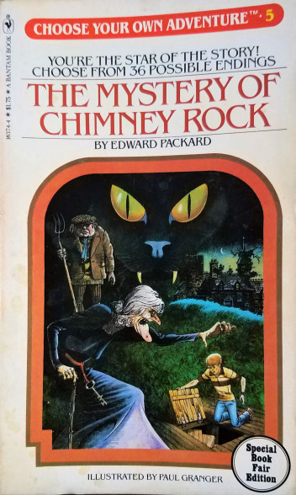
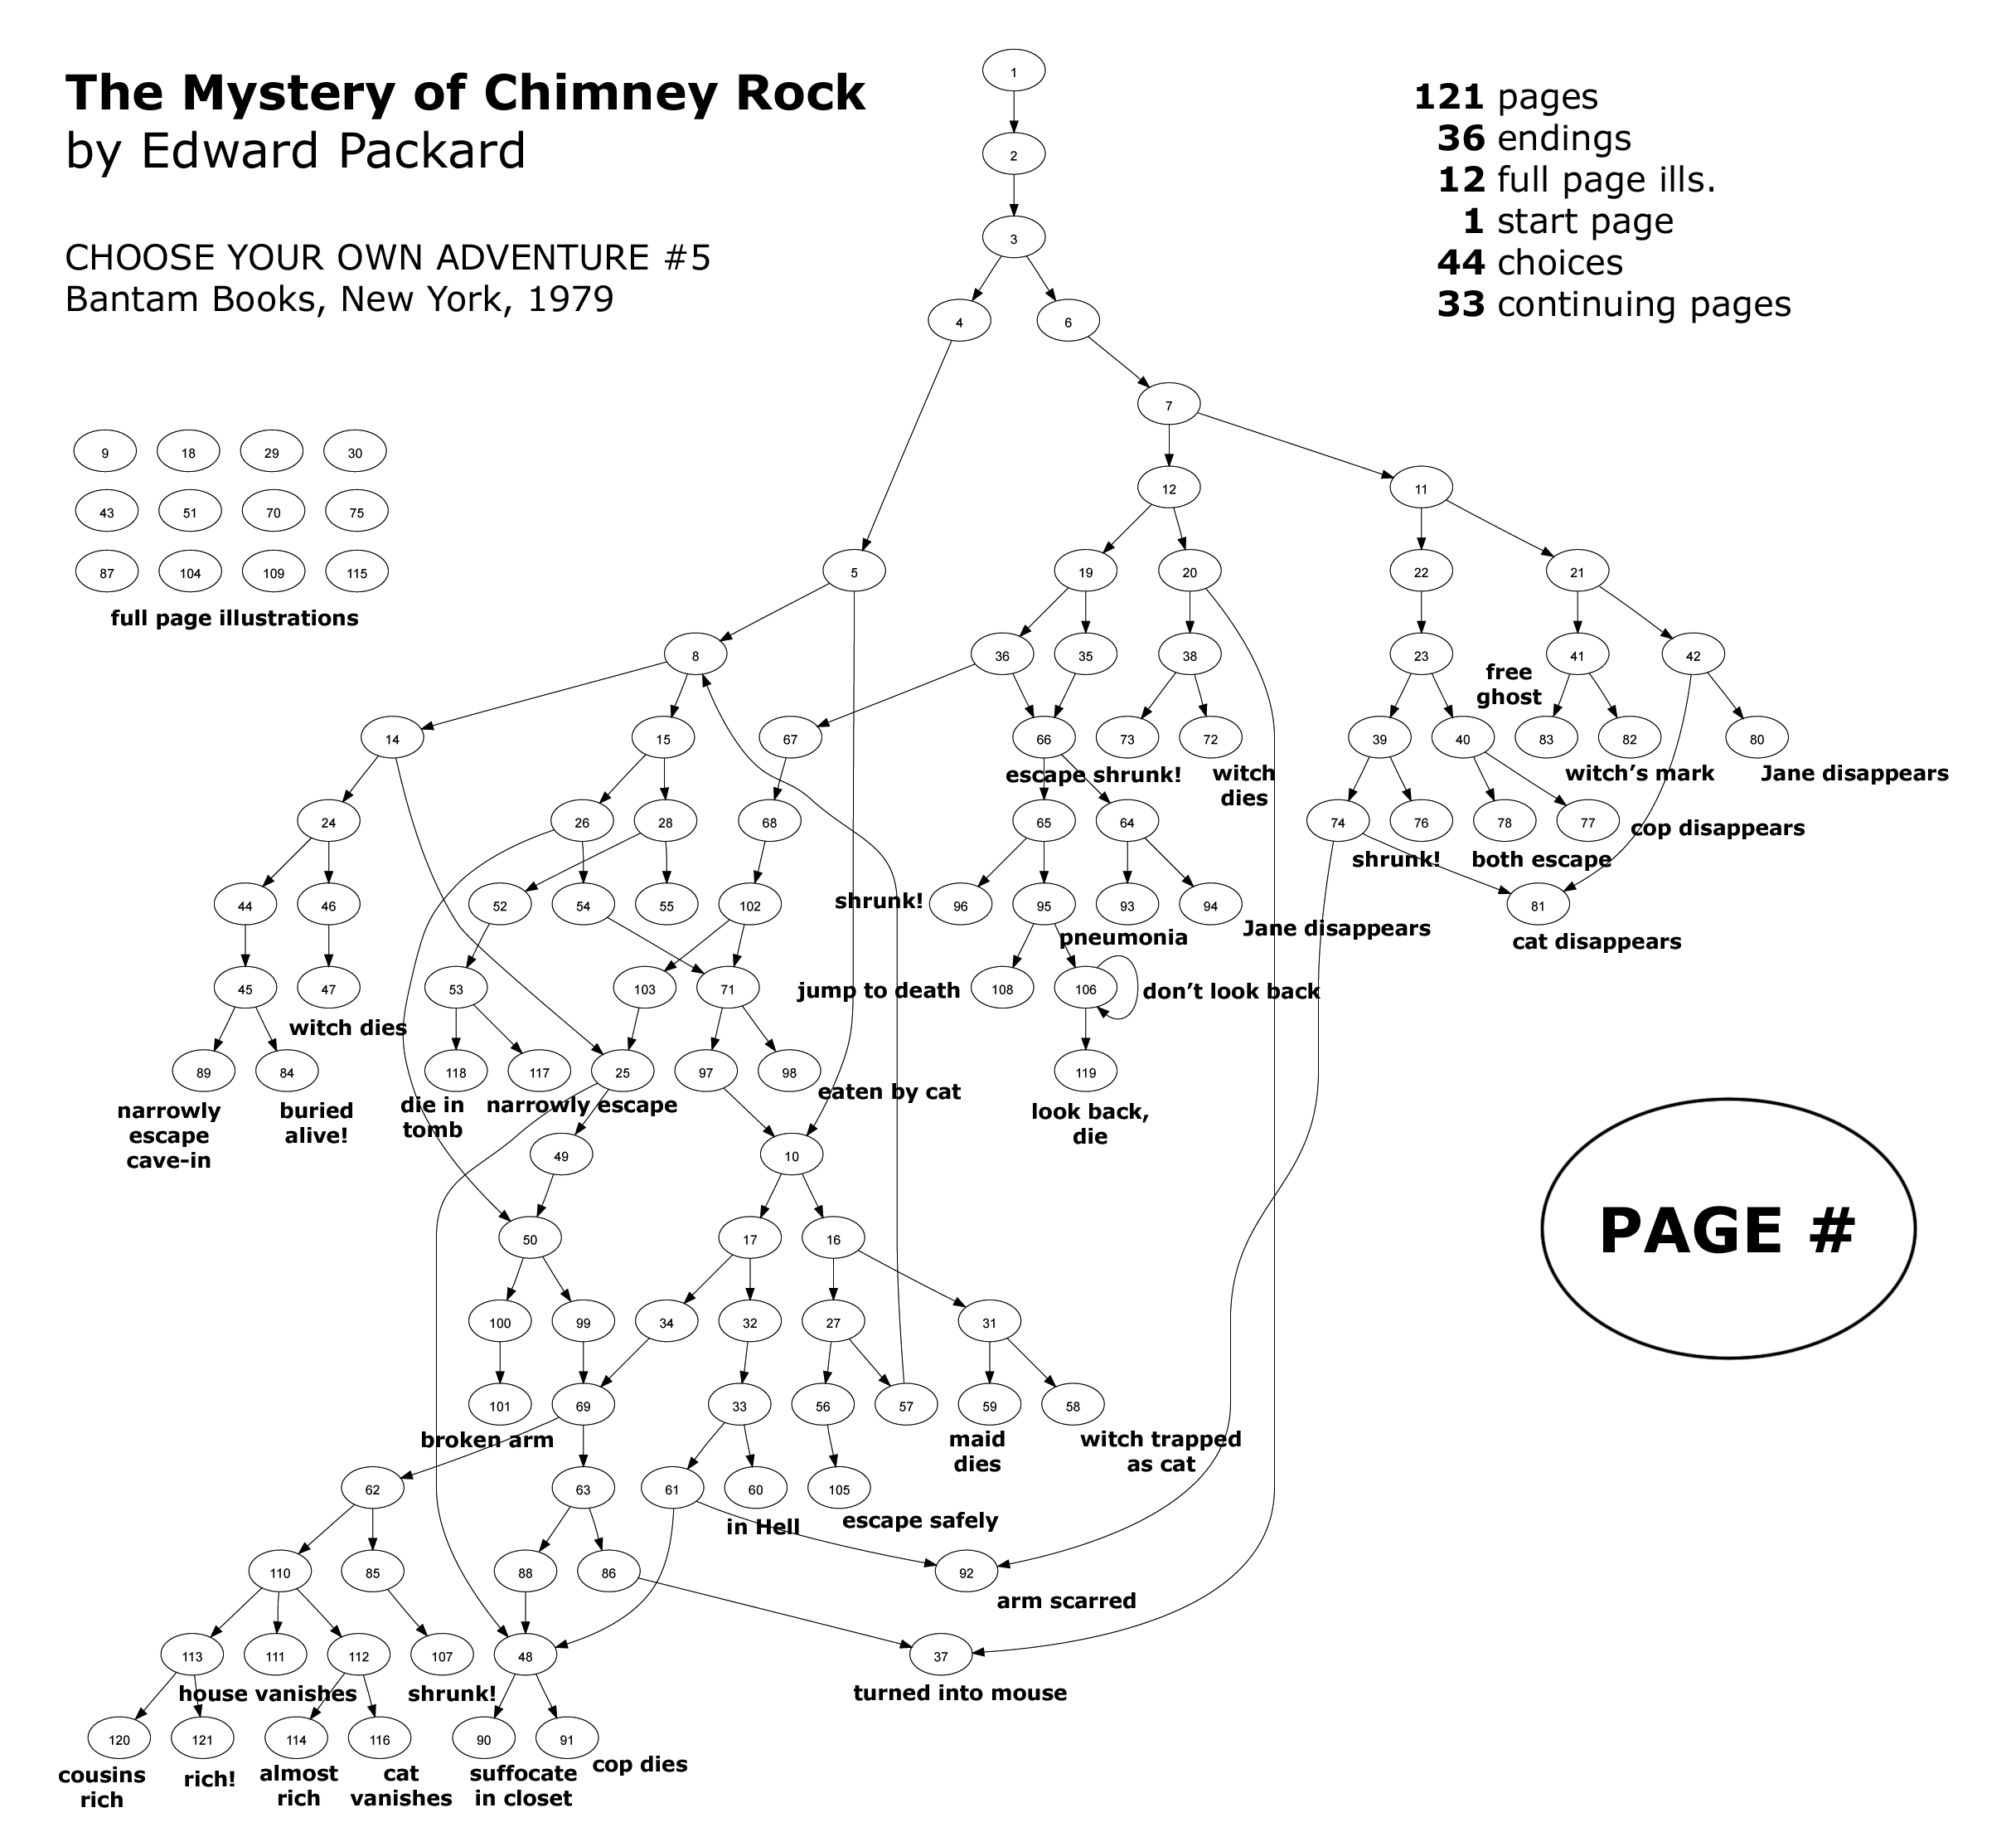
https://www.seanmichaelragan.com/html/[2008-03-07]_Choose_Your_Own_Adventure_book_as_directed_graph.shtml

Slide 16
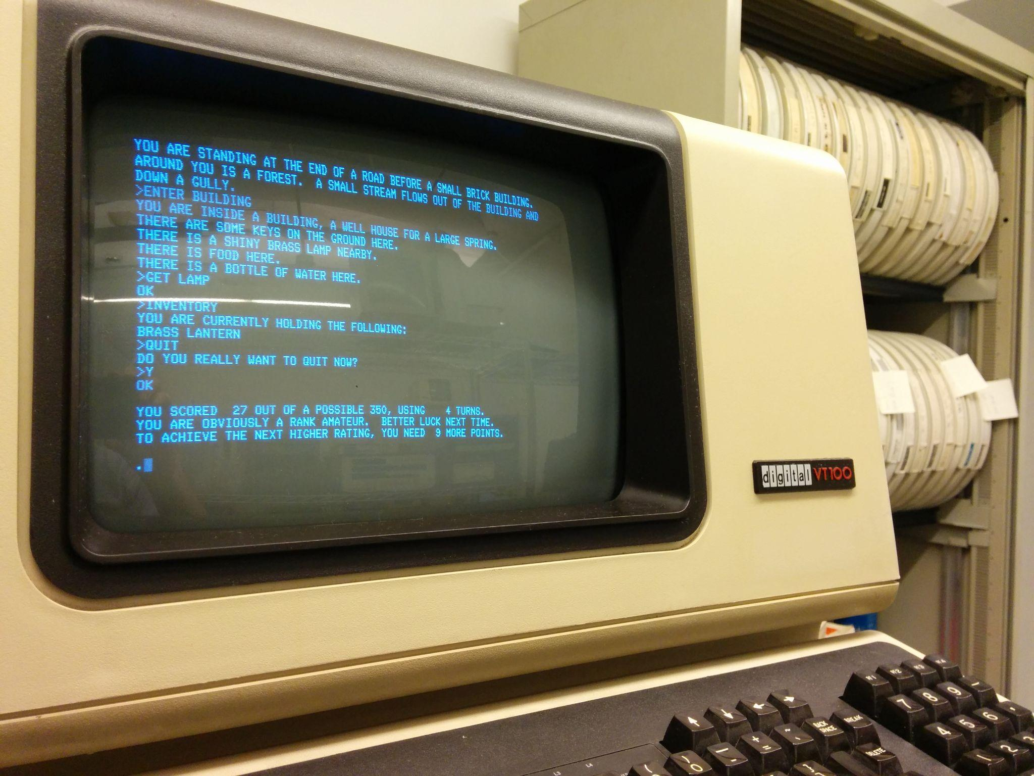
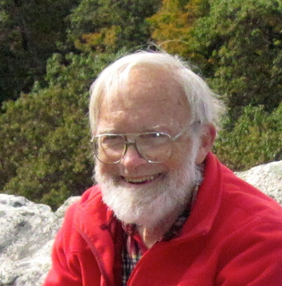
The Birth of Interactive Fiction Computer Games
Colossal Cave Adventure
Made in 1975 by Will Crowther
https://en.wikipedia.org/wiki/Colossal_Cave_Adventure#/media/File:Will_Crowther_Fall_2012.jpg
https://upload.wikimedia.org/wikipedia/commons/d/d8/Colossal_Cave_Adventure_on_VT100_terminal.jpg

Slide 17
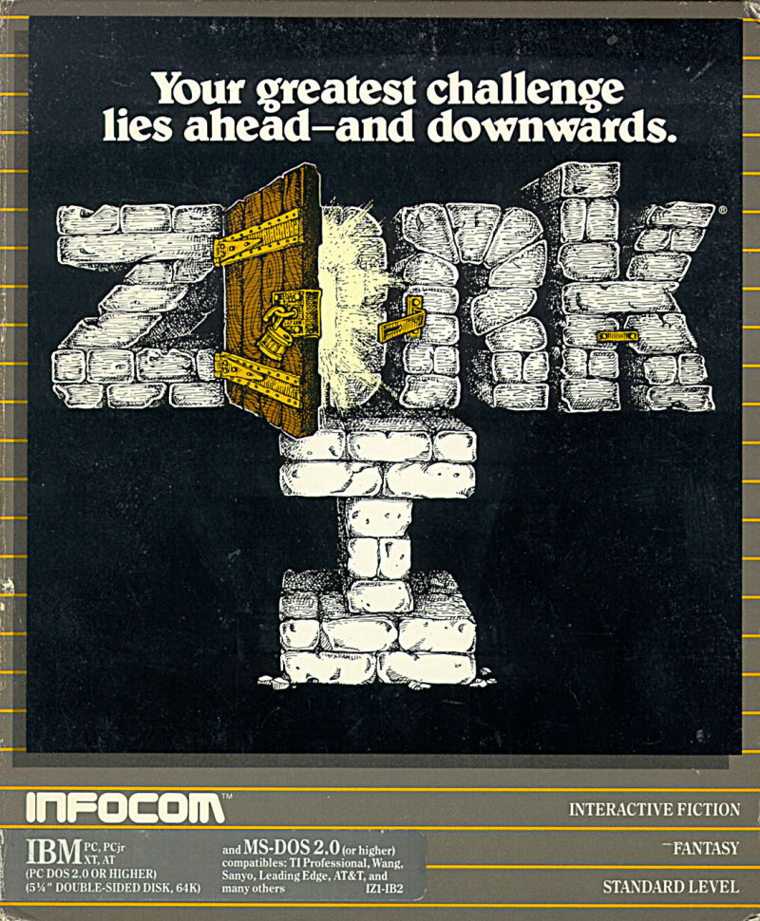
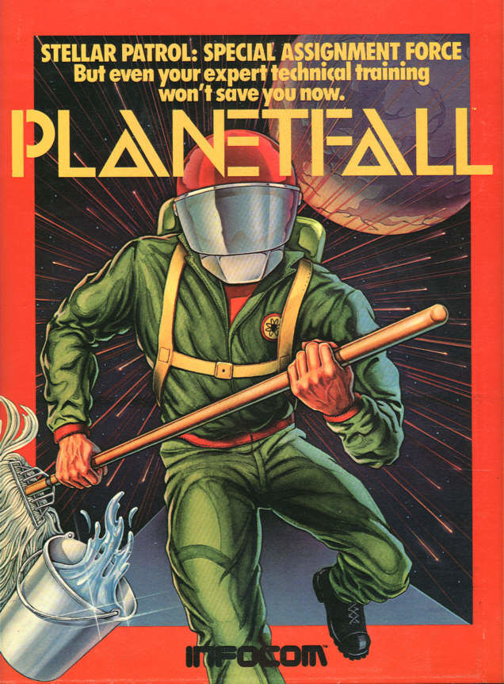
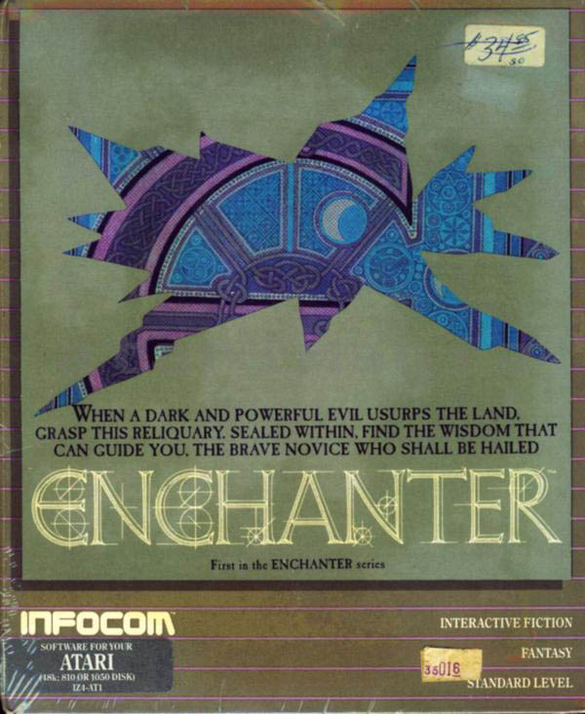
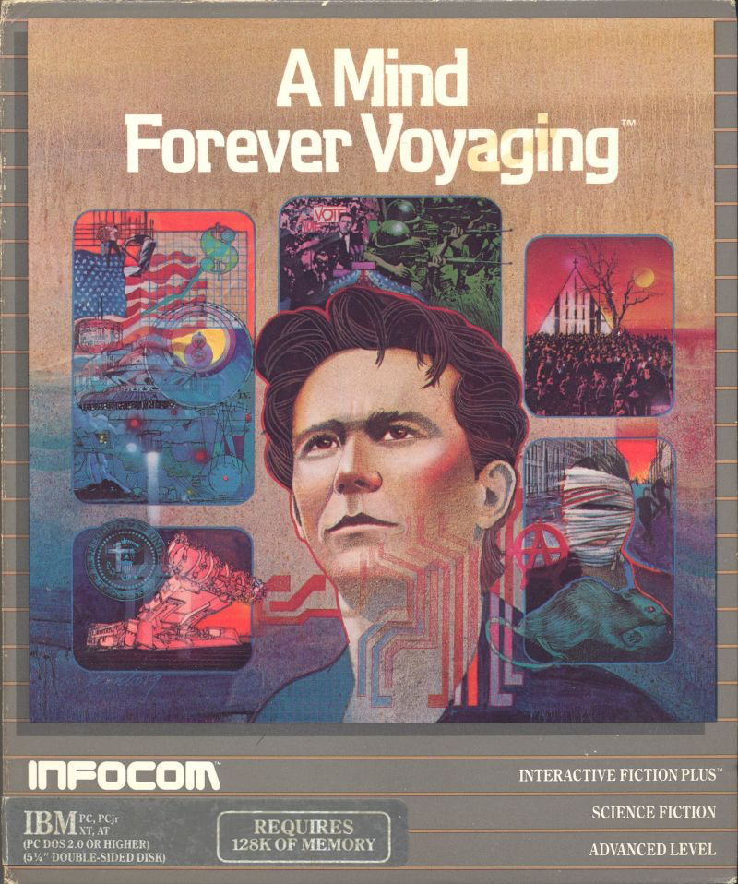
It became a thing
Interactive Fiction/Text Adventure Games were the best-selling computer games of the 1980s. A company called Infocom created the most popular titles.
1979
1983
1983
1985

Slide 18
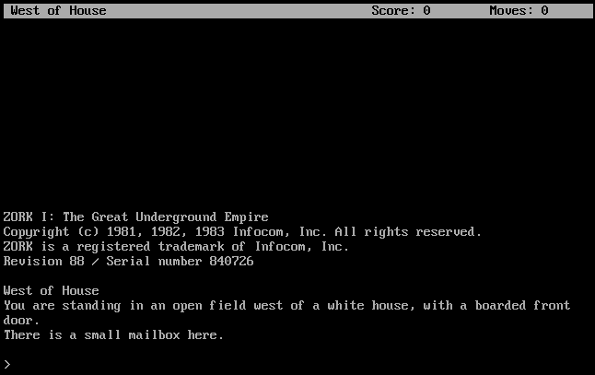
Notes:
Looked like this (from Zork I)

Slide 19
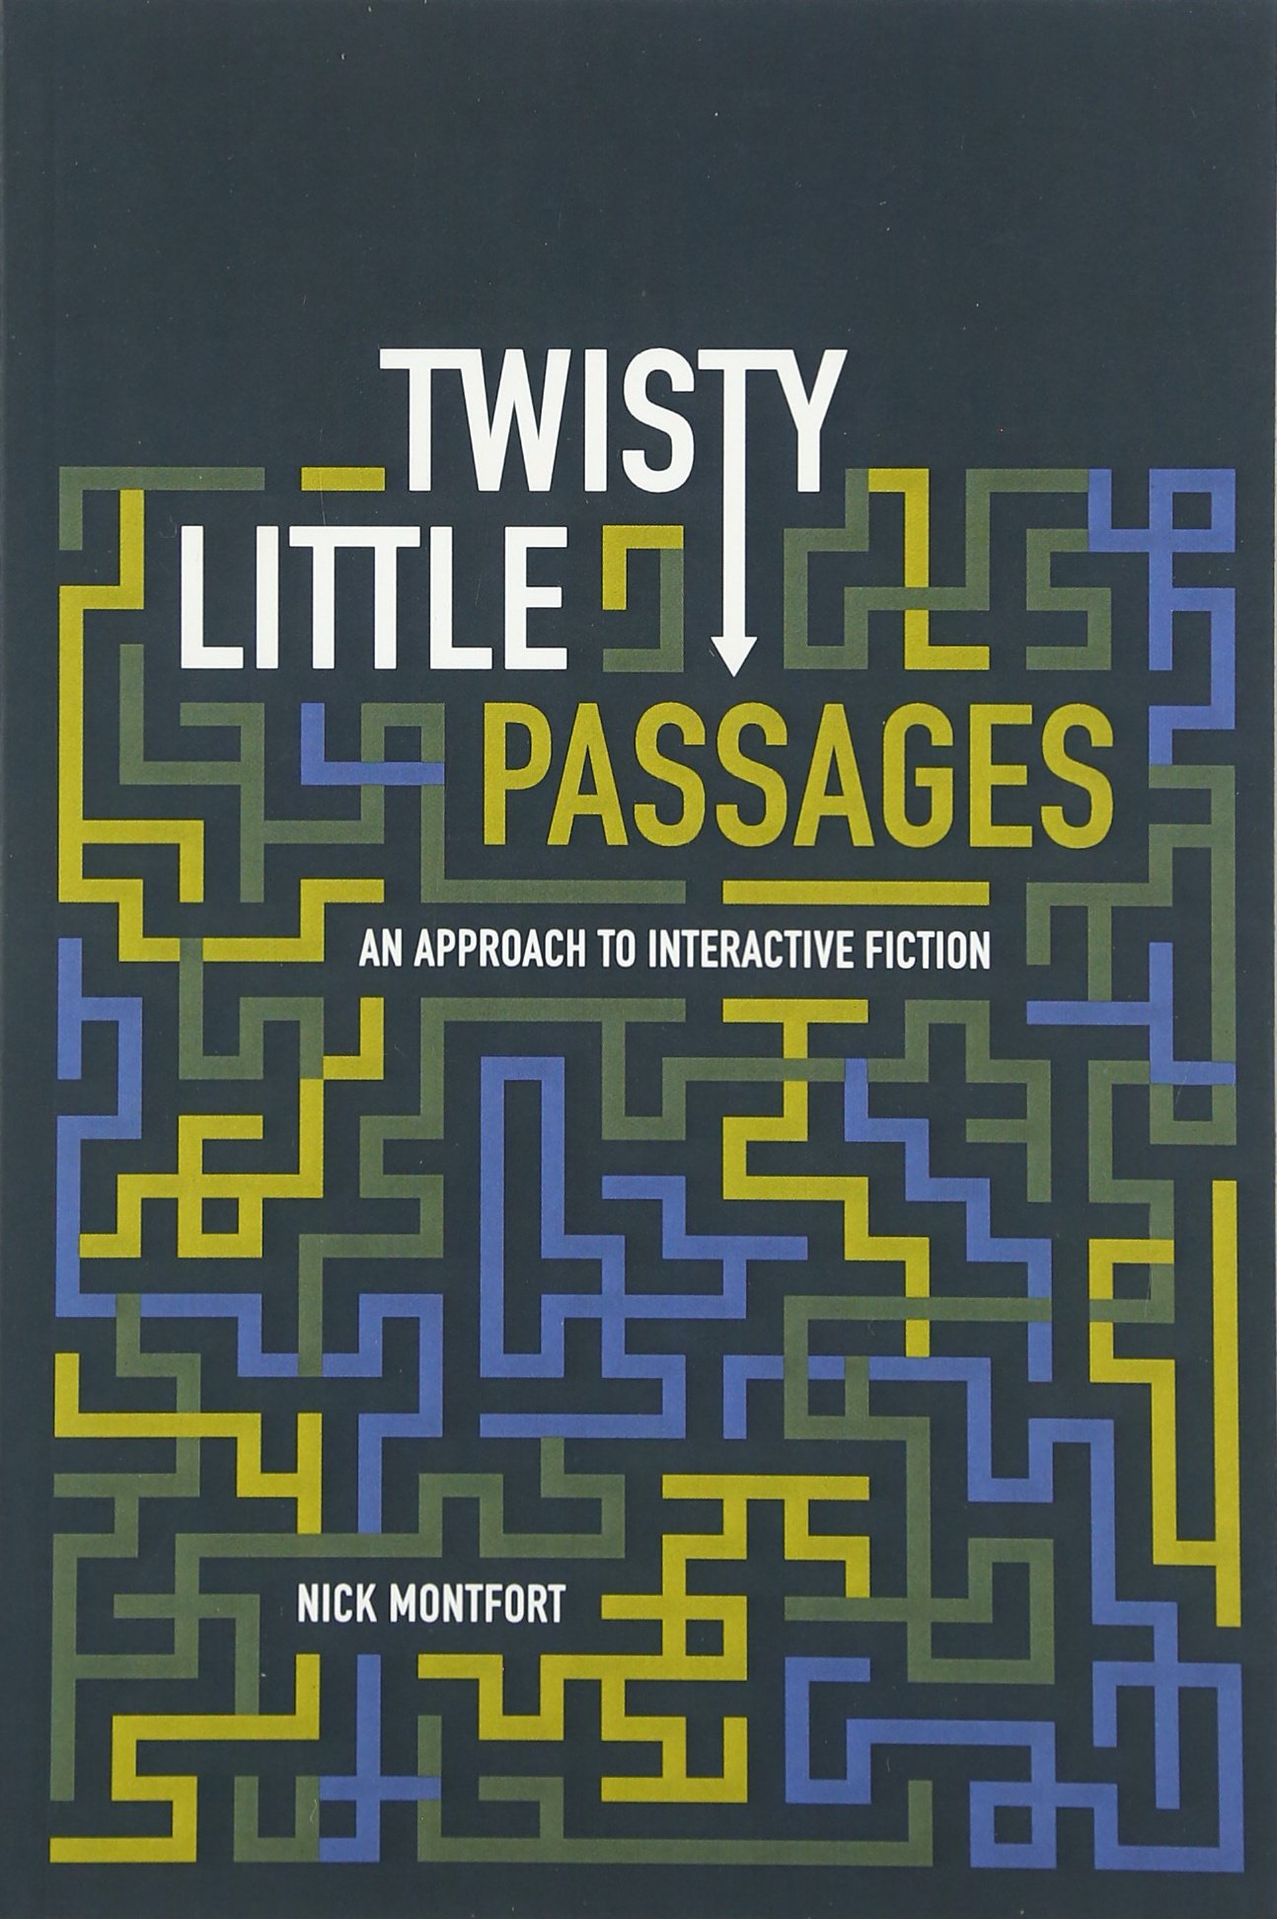
Components of Interactive Fiction Games
The parser, which is the component that analyzes natural language input in an interactive fiction work.
The world model, which is setting of an interactive fiction work.
Notes:
The simulated world is represented computationally in some sort of data structure or collection of objects. It is this simulated world that distinguishes a work of interactive fiction from a conversational character or from an expert system that employs natural language understanding.

Slide 20
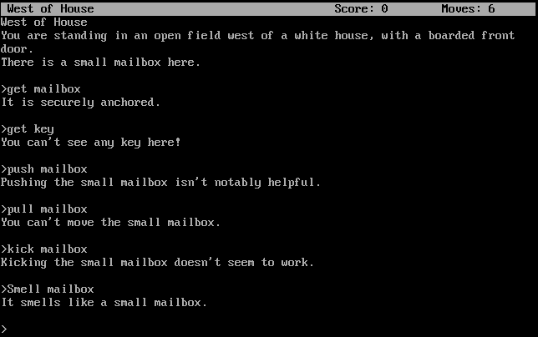

The Parser
Notes:
Regular expression

Slide 21
Commands
Players input simple sentences such as “get key” or “go east”, which are interpreted by a text parser. Parsers may vary in sophistication; the first text adventure parsers could only handle two-word sentences in the form of verb-noun pairs.
Notes:
In the case of Adventure’s “two-word” parser, which only accepts input of the form “verb” or “verb noun,” determining the grammatical structure of the input is trivial.

Slide 22
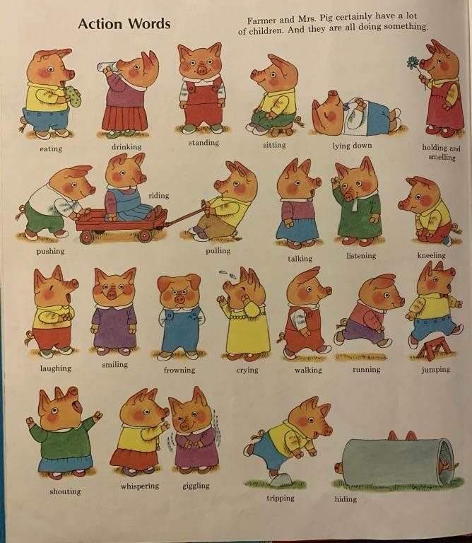
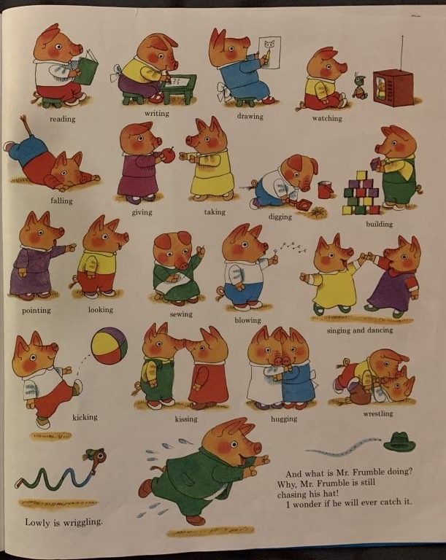
Notes:
Verbs

Slide 23
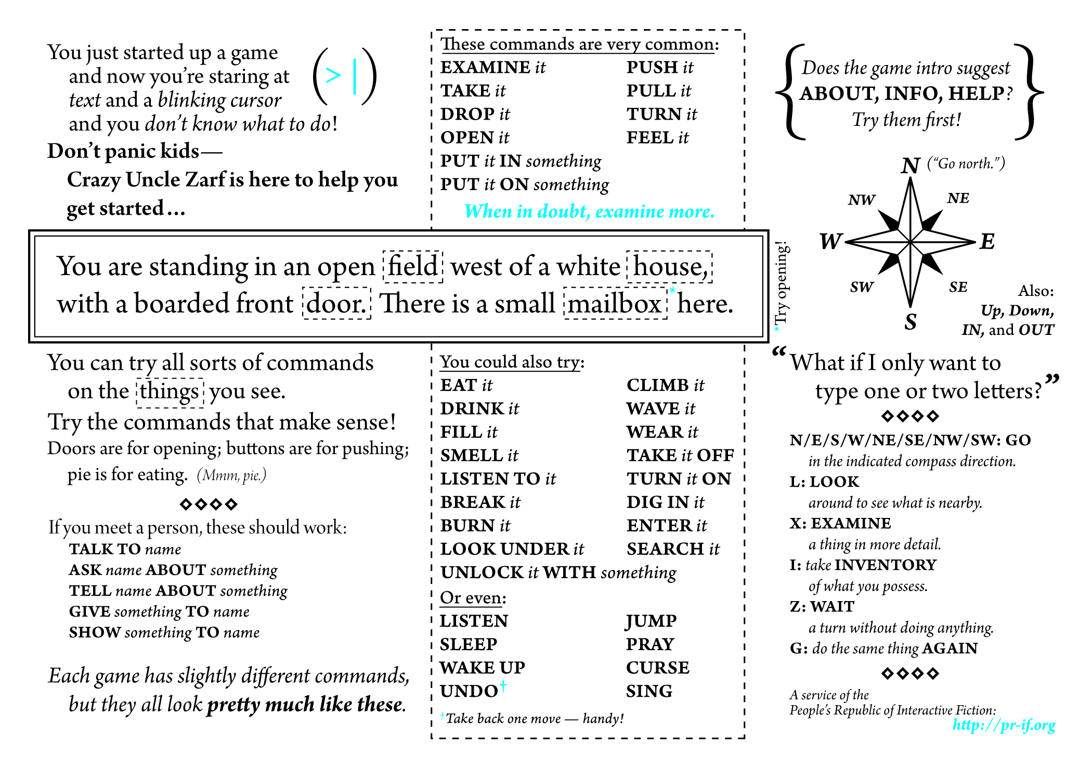

Slide 24
Vocabulary
The original Zork I (1980) had a 600-word vocabulary.
Trinity (1986) could understand stand 2,120 different words.

Slide 25


Early Parsers
Adventure’s verb-noun parser was extremely primitive but removed ambiguity.
Ambiguity means that there are multiple interpretations of a sentence, which denote distinct meanings.
Notes:
It only accepted verb-noun commands, so that limits the possible interpretations of sentences.
Adventure, with its primitive but effective way of understanding language, that endures and that became widespread. It also became the archetype of the text adventure and of interactive active fiction.

Slide 26
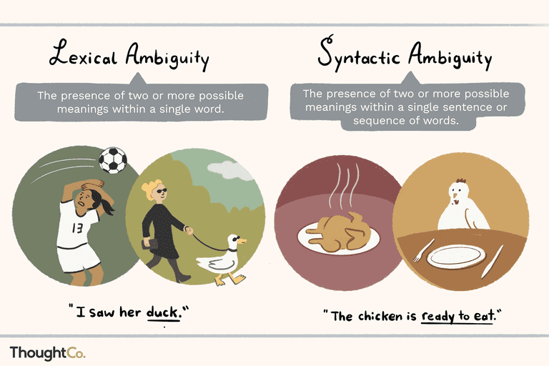

Slide 27
Basic Linguistics
Stop words: Function words like “the” could be stripped from user input, so that “GET THE LAMP” was sent to the parser as “GET LAMP”.
Prepositions: “LOOK AT” and “LOOK UNDER” were only considered different by the parser if they were implemented as separate verbs and mapped onto different actions.
Direct and indirect objects: Some parsers recognized direct and indirect objects like GIVE [THE BOOK] TO [CHRIS].
Notes:
Adventure has the player's character explore a mysterious cave that is rumored to be filled with treasure and gold. To explore the cave, the player types in one- or two-word commands to move their character through the cave, interact with objects in the cave, pick up items to put into their inventory, and other actions. The program acts as a narrator, describing to the player what each location in the cave has, the results of certain actions, or if it did not understand the player's commands, asking for the player to retype their actions.

Slide 28
“open the red box with the green key then go north”.
Later parsers, such as those built on ZIL (Zork Implementation Language), could understand complete sentences. They could handle more complex inputs.

Slide 29
Z-machine
Infocom developed a virtual machine to deploy standardized “story files” on many platforms.
The Infocom parser was the best of its era.
It accepted complex, complete sentence commands when its competitors’ parsers were restricted to simple two-word verb-noun combinations.
Its parser was actively upgraded, and later games would ‘understand’ multiple sentence input: ‘pick up the gem and put it in my bag. take the newspaper clipping out of my bag then burn it with the book of matches’.
Notes:
Infocom developed a custom virtual machine that could be implemented on a large number of platforms, and took standardized “story files” as input. Infocom was responsible for developing the interactive style that would be emulated by many later interpreters. The Infocom parser was widely regarded as the best of its era. It accepted complex, complete sentence commands like “put the blue book on the writing desk” at a time when most of its competitors parsers were restricted to simple two-word verb-noun combinations such as “put book”. The parser was actively upgraded with new features like undo and error correction, and later games would ‘understand’ multiple sentence input: ‘pick up the gem and put it in my bag. take the newspaper clipping out of my bag then burn it with the book of matches’.

Slide 30




Why were parsers so bad?
Limited computational resources. Computers had ≤128 KB of memory
Language is difficult. There are many things that make human languages genuinely challenging for a computer to process.
Keyword-based commands. Only exact matches worked properly. No synonyms, no paraphrases.
Everything was manual. Game developers had to anticipate all possible commands, and manually code the responses.
No machine learning. This was prior to the advent of machine learning based natural language processing

Slide 31
Components of Interactive Fiction Games
The parser, which is the component that analyzes natural language input in an interactive fiction work.
The world model, which is setting of an interactive fiction work.
Notes:
The simulated world is represented computationally in some sort of data structure or collection of objects. It is this simulated world that distinguishes a work of interactive fiction from a conversational character or from an expert system that employs natural language understanding.

Slide 32
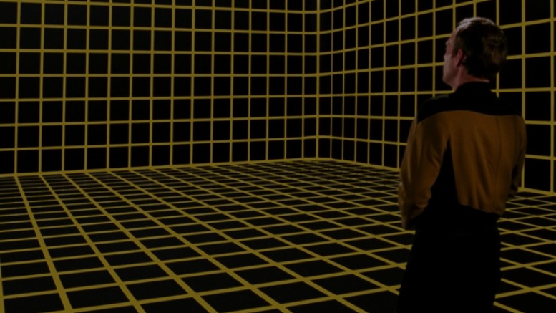
World Model
It represents the physical environment, and things like • Settings or locations • Physical objects in each setting • The player’s character • Non-player characters It also represents and simulates the physical laws of the environment.
Notes:
The world model is typically implemented in the interactive fiction program as some type of graph or tree with associated procedures.

Slide 33
Locations
You are at a complex junction. A low hands and knees passage from the north joins a higher crawl from the east to make a walking passage going west. There is also a large room above. The air is damp here.
A location in Colossal Cave Adventure
Notes:
https://en.wikipedia.org/wiki/Colossal_Cave_Adventure

Slide 34

Navigation in a Text-based World
Cardinal Directions: Go North/South/East/West/
Northwest/Northeast/Southwest/Southeast
Also: Go Up, Down, In and Out
One letter commands were also supported: N/E/S/W/NE/SE/NW/SW
Look/L: look around to see what is nearby
Not every direction is possible in every location.

Slide 35
Colossal Cave Adventure
You are standing at the end of a road before a small brick building. Around you is a forest. A small stream flows out of the building and down a gully.
> go south
You are in a valley in the forest beside a stream tumbling along a rocky bed.
Notes:
Adventure has the player's character explore a mysterious cave that is rumored to be filled with treasure and gold. To explore the cave, the player types in one- or two-word commands to move their character through the cave, interact with objects in the cave, pick up items to put into their inventory, and other actions. The program acts as a narrator, describing to the player what each location in the cave has, the results of certain actions, or if it did not understand the player's commands, asking for the player to retype their actions.

Slide 36
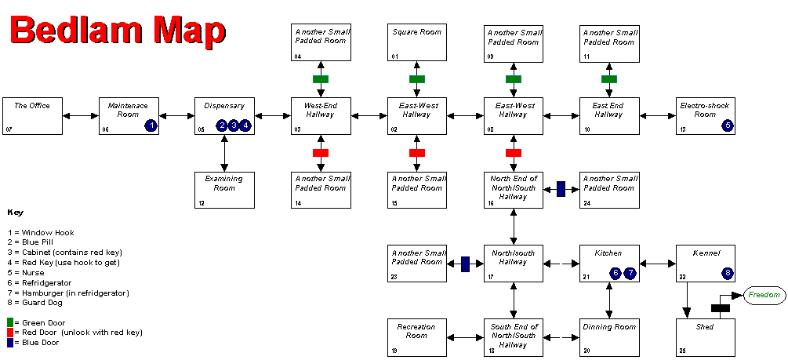
As a Data Structure
You can implement an IF game as a directed graph.
Each location in a node in the graph.
Edges are connections to adjacent locations.
Edges are labeled with the direction.
Possible commands at a location are
the labels of the outward edges.
Locations can hold Objects.

Slide 37
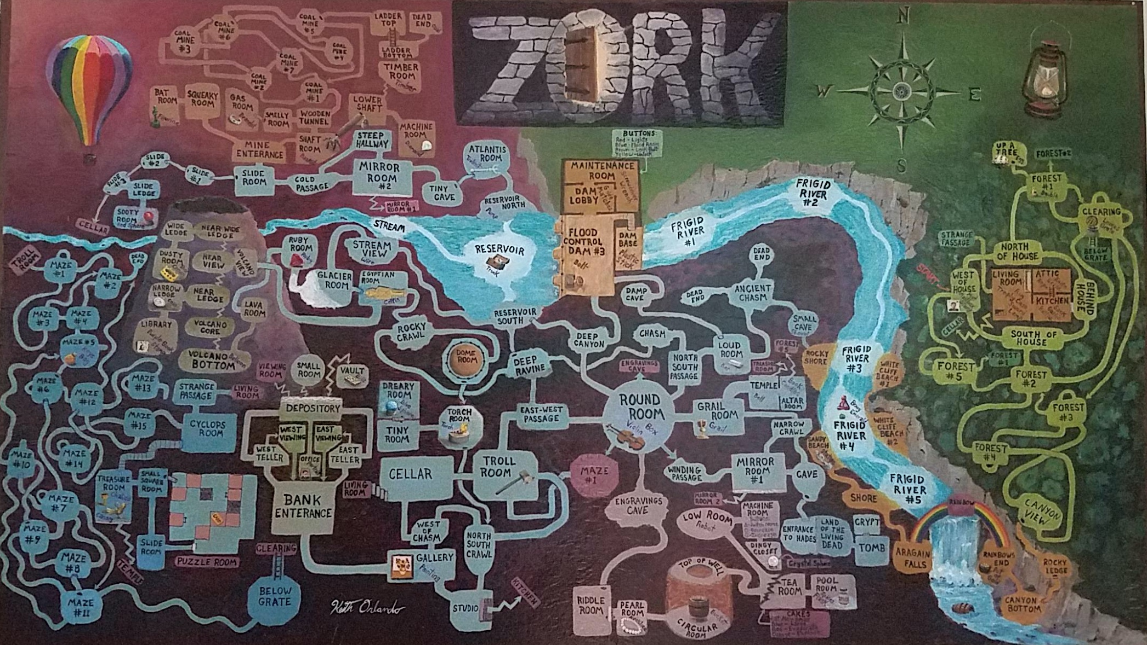
Notes:
Credit: Reddit user ion_bond Source URL: https://www.reddit.com/r/zork/comments/5ximil/zork_map_mit_version_fantastic_game_i_spent_some/

Slide 38
Objects
In Adventure, instead of a realistic simulation of caving, the author placed five treasures within as an incentive to explore the cave.
The player had to figure out how to get past a snake to move deeper into the cave. The player is attacked by dwarves and their treasure is stolen by a pirate.

Slide 39
Examine Lamp
Items represent things in the game world. Usually they are mentioned in the description of a location like:
You are on the dungeon stairs. From above, you can make out some of the king’s guards talking about current events. Someone’s left an old lamp here.
Players can inspect them with the “EXAMINE” command.
> EXAMINE LAMP This old lamp seems like it’s seen some use. It ran out of oil ages ago.

Slide 40
Get Lamp
Players can pick up objects in the world, and they are added to the player’s inventory with the “GET” command. The inventory is the set of things that the player has collected along the way.
Oftentimes, they are used to solve puzzles. For instance, you must have a lamp in your inventory in order to explore a dark cave. To list all items that you have, you can issue the “INVENTORY” command (or just the letter “I”).

Slide 41
Light lamp
Objects often have special commands associated with them. For instance, in order to solve the darkness puzzle you must say “LIGHT LAMP”.
Some special commands require more than one object in your inventory.

Slide 42
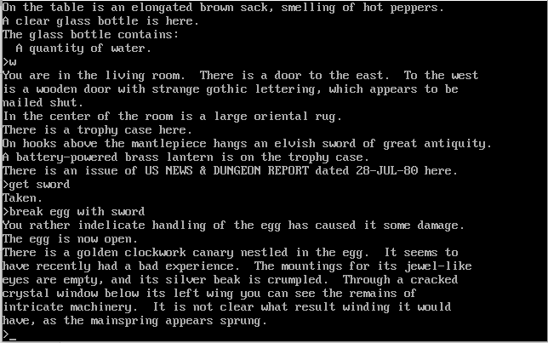

Notes:
BREAK EGG
BREAK EGG WITH SWORD

Slide 43
Object properties
Containment: Objects may have contents (the bottle can have wine in it)
Weight: Objects have weight (some objects might be too heavy to lift)
Position: An object may be in, on, or under another object

Slide 44
People are objects too
In Zork, a handful of living opponents thwart the adventurer: the troll, who stays put in a single room and serves as an obstacle; the vampire bat, who can carry off the adventurer; the cyclops, who can dine on the adventurer; and the thief, who wanders around the underground areas stealing items from the adventurer.
These people/opponents can be implemented as objects too. People objects often have a special command for dialogue via “TALK TO”.

Slide 45
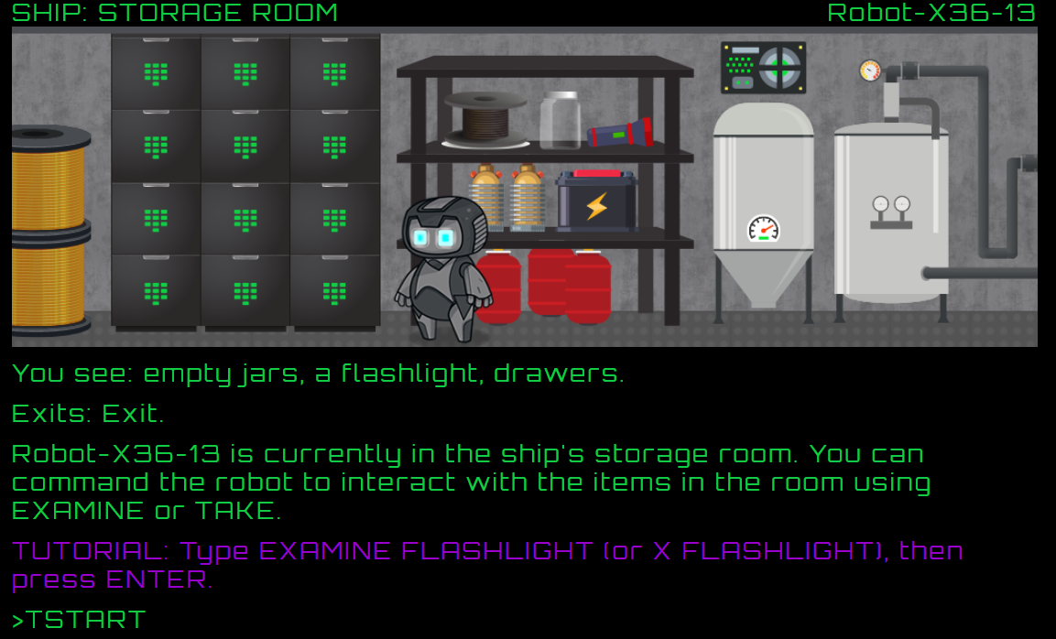
In-class Activity: Play a Game (5 min)
And answer these question:
What commands did you try that didn’t work?
How does this experience differ from reading a non-interactive story?
https://grizel.itch.io/sentient-beings
Record your game by typing “TSTART” at the beginning.
Type “TSTOP” to download your game.
Notes:
Can they

Slide 46
Puzzles
In most interactive fiction, puzzles (sorts of challenges or obstacles) are part of the world the player character moves through. In order to complete the IF work, the interactor must figure out how to meet these challenges.

Slide 47
Puzzle Solutions
The solutions may be arrived at through the player character’s senses or by having the player character manipulate things in the surroundings and then observe the results to determine the workings of the world.
Most interactive fiction does not have great replay value. You cannot simply “replay” a riddle if you know its answer.
However, once you learn to play a board game, the knowledge gained from playing it once game doesn’t ruin the experience of playing it again.

Slide 48
Zork’s diamond machine
In the coal mine, the player character finds a machine with a tiny slot in the top of it. What this machine does, and how to turn it on, is unclear.
The solution is to put some coal into the machine, and then turn on the machine using the screwdriver. This results in the coal being compressed with great force producing a diamond.
The player can act as scientist and put anything inside, then observe the results.

Slide 49
Guess the Verb
A few puzzles require the player “guess the verb” and perform an action that would not be obvious from the commands available. The game's parser does not understand unless the player uses a particular way to phrase the command (sometimes non-obvious).
For example, if there is a crate to be opened with a crowbar and the only way to open it is to "pry crate with crowbar", other actions like "open crate with crowbar" give a misleading response. Usually this is a deficiency in the parser. Some games like Ad Verbum by Nick Montfort intentionally include guess-the-verb puzzles to good effect in contexts where the puzzles are explicitly about language.

Slide 50
IF Summary
What’s the difference between TTRPGs like D&D and Choose-Your-Own-Adventure games?
Why were IF commands so simple?
What makes IF games hard to win?

Slide 51
Automated Story Generation

Slide 52
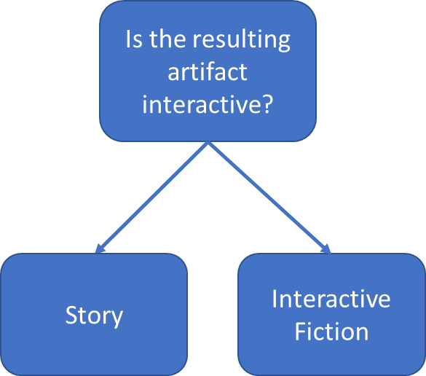
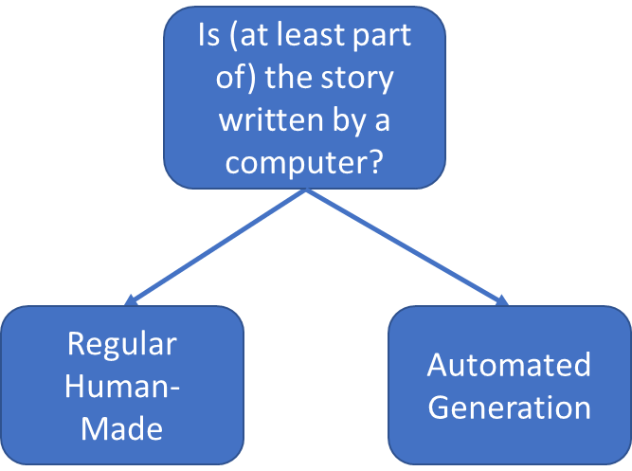
Interactive Fiction vs Automated Story Generation
What is it?
How was it made?

Slide 53
Early Systems
TALE-SPIN (1977):
One day,
JOE WAS THIRSTY.
JOE WANTED NOT TO BE THIRSTY.
JOE WANTED TO BE NEAR THE WATER.
UNIVERSE (1984):
>> LIZ tells NEIL she doesn’t love him
working on goal – (WORRY-ABOUT NEIL) – using plan BE-CONCERNED
Possible candidates – MARLENA JULIE DOUG ROMAN DON CHRIS KAYLA
Using Marlena for WORRIER
>> MARLENA is worried about NEIL

Slide 54
Common Automated Story Generation Methods
Using a neural network to generate the next, likely word. Thus, creating stories one word at a time.
More in Module 1: Neural Language Models!
Using “plot graphs” to decide which path to take (like the computer is playing a Choose-Your-Own adventure game!)
More in Module 2: Scripts and Story Structure!

Slide 55
Supplemental Materials
Get LAMP (documentary): https://www.youtube.com/watch?v=LRhbcDzbGSU
Adventuron Classroom: https://adventuron.io/classroom/
Tutorial: https://adventuron.blogspot.com/2019/07/video-tutorial-beginners-guide-to.html
Action Castle (Jared Sorensen): https://www.youtube.com/watch?v=Sehaj4mw38s
An Introduction to AI Story Generation (Mark Riedl): https://mark-riedl.medium.com/an-introduction-to-ai-story-generation-7f99a450f615
How to Make a Text-Based Adventure: Commands and Parser: https://h2g2.com/edited_entry/A20600641
Play some IF games on Itch.io: https://itch.io/games/tag-interactive-fiction/tag-text-based

Slide 56
Course Overview

Slide 57
Course-Long Learning Objectives
Understanding the challenges of creating text-based games and automatically generating stories.
Implement and appraise the value of different technologies (Neural Language Models, Dialogue Systems, Scripts, Planning, and Commonsense Reasoning) in story generation/interactive fiction playing.
Argue for the appropriate components of a working story generation system or interactive fiction–playing system.
Create your own story generation system or interactive fiction–playing system.

Slide 58
Topics
Building a text adventure game (Module 0)
Neural Language Models for IF world creation and story generation (Module 1)
Story structure and cause-and-effect (Module 2)
Planning toward a goal for IF playing and story generation (Module 3)
Commonsense reasoning and representing knowledge in the story world (Module 4)
Character modeling and dialog (Module 5)

Slide 59
Bonus material (Module 6)
Reinforcement learning for playing IF
Story ending prediction
Mixed methods for story generation
Story evaluation
Other topics you want to know about!

Slide 60
Grading
Six homeworks = total of 55% of final grade
Can be completed in groups ≤ 2 (just make sure to put both your names on it!)
One final project = 35%
Can be completed in groups ≤ 4
Participation + One paper presentation = 10%

Slide 61
Student Presentations
Prepare a 10-15 minute presentation on a paper from the reading list.
Your presentation should summarize the work and discuss the ways it’s applicable to either interactive fiction or automated story generation.
Grading:
50%: Send us your slides by Monday at 3 PM the week of your presentation
50%: presentation to the class

Slide 62
How to Contact Us
Ed Discussion (https://edstem.org/us/courses/18119/) – Also accessible via Canvas
Email us with specific questions
Instructors: ccb@seas.upenn.edu, laramar@sea.upenn.edu
TAs: artemisp@seas.upenn.edu, ldugan@seas.upenn.edu

Slide 63
Office Hours
Mondays 1-2PM EST - Chris
Tuesdays 3:15-4:15 PM EST (after class) - Liam
Thursdays 3:15-4:15 PM EST (after class) - Lara
Fridays 12:15-1:15 PM EST - Artemis
(Zoom links on the website: http://interactive-fiction-class.org/staff.html)

Slide 64
Homework 1
Homework 2
Implement a simple text adventure game in Python.
Due 01/17/22 at 11:59PM EST
Learn how to work with transformer language models for interactive fiction.
Due 01/31/22

Slide 65
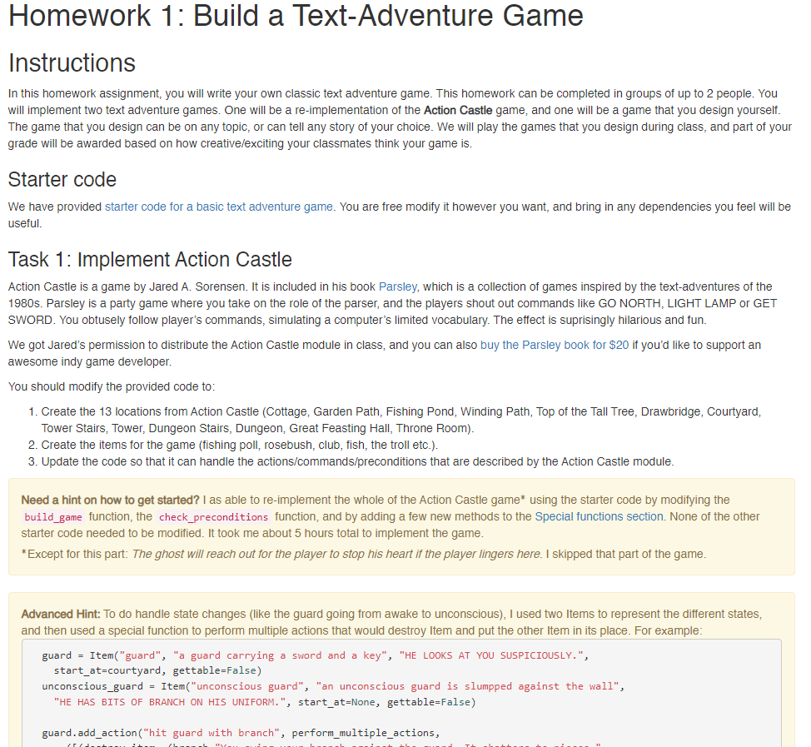
http://interactive-fiction-class.org/
homeworks/text-adventure-game/
text-adventure-game.html
Notes:
Tutorial on how to use colab, and how to save file to your own Github

